Slide 1
Week 6ish: Greedy Algorithms
CS 5800
Dr. Alan Jamieson

Slide 2
What’re we talking about today, Alan?
Specifying Greedy Algorithms
Minimum Spanning Tree
Kruskal’s Algorithm
Prim’s Algorithm
Huffman Encodings
Final Project Introduction

Slide 3
Looping back to greedy:
Recap:
Build a solution piece by piece.
At each “decision” point, choose the best piece (i.e. the piece that gets us closest to the solution)
Do not allow for backtracking.
Does not guarantee optimality, but is typically very fast.

Slide 4
Goddard’s Definition:
The elements of a greedy algorithm/problem are:
1. A set C of candidates
2. A set S of selected items
3. A solution check: does the set S provide a solution to the problem (ignoring questions of optimality)?
4. A feasibility check: can the set S be extended to a solution to the problem?
5. A select function which evaluates the items in C
6. An objective function

Slide 5
Now you:
In your groups, design an algorithm to give change with the fewest number of coins utilizing a greedy method. Does it work for all coin values? Why is the answer no?
1, 5, 10, 25
a, b, c, d

Slide 6
Coin changing problem
How do you make change in the US with the minimum number of coins (1c, 2c, 5c, 10c, 25c, 50c)?

Slide 7
Coin changing problem
How do you make change in the US with the minimum number of coins (1c, 2c, 5c, 10c, 25c, 50c)?
Candidates - infinite collection of coins, C Selection - a subset S ⊆ C of the candidate coins Solution check - Does S add up to our target value? Feasibility check - Does adding c ∈ C total to more than required? Select function - (maximize) value of the coin Objective function - (minimize) number of coins

Slide 8
Now you:
Consider our two earlier problems: minimal dominating set and maximal matching. Specify these two problems using the greedy algorithm definition elements from Goddard.
Breakout rooms: when completed, come back to the main room.

Slide 9
Our next problem:
One of the things that we get by using DFS is a spanning tree
Spanning tree: subset of edges of an undirected, connected graph that, when induced, creates an acyclic graph that includes all vertices in that graph.
Minimum Spanning Tree (MST): given a connected, weighted, undirected graph, what’s the smallest (by edge-weight sum) spanning tree?

Slide 10
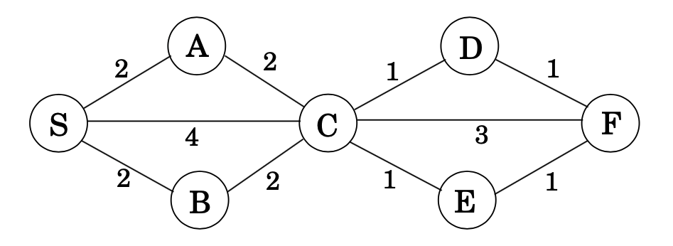
Example:
Credit: Dasgupta, problem 4.18

Slide 11
Specification:
Candidates - edges Selection - a subset S⊆ E of the candidate edges Solution check - does S touch every vertex, is it connected? Feasibility check - does adding e ∈ E create a cycle? Select function - edge weight Objective function - sum of weights

Slide 12
A simple greedy approach:
Assume the graph is “correct” meaning weighted, undirected, and connected.
Just choose the edges with the smallest weight that do not create a cycle!

Slide 13
Example:
Credit: Dasgupta, problem 4.18

Slide 14
A simple greedy approach:
Assume the graph is “correct” meaning weighted, undirected, and connected.
Just choose the edges with the smallest weight that do not create a cycle!
Does this guarantee optimality? How long does this take?

Slide 15
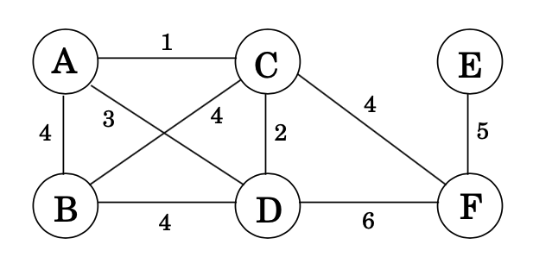
Now you:
Using the simple greedy approach, find the MST of the graph below:
Breakout rooms: when completed, send me a slack message.
Figure credit: Dasgupta, 5.1

Slide 16
Continuing with MST
Can we do better than our simple greedy approach?
One thing we can note: trees are recursive!
What if we considered utilizing the recursive nature of trees and build the spanning tree by building trees and combining them?

Slide 17
Kruskal’s Algorithm
Developed by Joseph Kruskal in 1956, this MST greedy algorithm builds the MST by developing trees and combining them.

Slide 18
Algorithm
function kruskal(G, w): Input: A connected, undirected graph G=(V,E) with edge weights w Output: A minimum spanning tree defined by the edges in X
for all u in V: makeset(u) X = {} sort the edges E by weight
for all edges {u,v} in E, in increasing order of weight: if find(u) != find(v) add edge {u,v} to X union(u,v)
makeset(x): create a singleton set containing just x. find(x): which set does x belong union(x,y): merge sets x and y

Slide 19
Kruskal’s Algorithm
Developed by Joseph Kruskal in 1956, this MST greedy algorithm builds the MST by developing trees and combining them.
Basically:
Start with trees of single vertices. Consider each edge uv in order of weight. Add that edge to the set if it doesn’t create a cycle. Combine the tree containing u and the tree containing v. Complexity? O(E log V) - why?
Notes:
E is obvious. But log V is due to the find() operation. Could be as bad as E*V depending on data structure, but a linked list with a balanced update keeps this to log.

Slide 20
Example?

Slide 21
How about another option? Prim’s Algorithm
While commonly attributed to Robert Prim (1957), it was originally described by Vojtěch Jarník in 1930. Dijkstra also independently developed the algorithm in 1959. Instead of choosing edges regardless of location (and merging the resulting trees in the case of Kruskal’s), Prim’s grows a tree from an arbitrary starting vertex.

Slide 22
Algorithm
function prim(G, w): Input: A connected undirected graph G=(V,E) with edge weights w Output: A minimum spanning tree defined by the array prev
for all u in V: cost(u) = inf prev(u) = null visited(u) = false pick any initial node u0 cost(u0) = 0
H = makequeue(V) //priority queue, cost-values as keys while H is not empty: v = deletemin(H) visited(v) = true for each {v,z} in E: if cost(z) > w(v,z) && !visited(z): cost(z) = w(v,z) prev(z) = v

Slide 23
Prim’s
Basically:
Initialize vertices with a +inf cost value. Pick a starting vertex. Create a priority queue with V, sorted by cost. Pull the smallest cost vertex v, add that vertex to the MST. For all edges vz in E, if the weight along vz is smaller than the current cost of z AND z has not been already added to our MST, update cost(z)
Complexity? O(E log V) too. Though again, depends on data structure used. Adjacency matrix is O(E*V).

Slide 24
Example?

Slide 25
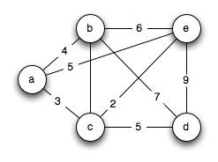
Exercise:
Given the following graph, run both Kruskal’s algorithm and Prim’s algorithm.
Come back to the main room when complete!

Slide 26
Final Project Introduction
Implementation of an algorithm from a curated list.
Written report detailing the choice of approach, analysis of algorithm and data structures used, and reflection.
15 minute presentation of the algorithm and code demo on the final day (December 9th).
Groups of 2-3. Self-selected groups allowed until November 8th.
Group “leader” must email me the names of group members, copying those group members on the email.
Full specification available soon.

Slide 27
On your radar:
Homework #4: due tonight!
Synthesis #2: due next week
Reading: Goddard B.2; Dasgupta Chapter 6; Skiena Chapter 10

Slide 28
One more problem: encodings
One common task in data storage is handling the encoding of that storage in order to save space. What’s the issue?
Consider a string of length T = 130 million, with an alphabet G = {a, b, c, d}. How do we encode this? We could use normal char values (8 bits), but that might get pretty big. Can we do better?

Slide 29
Possible solutions:
T = 130 million, G = {a, b, c, d}
Correlate each alphabet character with a two bit symbol:
a = 00 b = 01 c = 10 d = 11
Gets us around 260 mb to encode. Can we do better?
Notes:
Note, mb not MB

Slide 30
Possible solution 2:
What if we know something about the frequency?
a = 70 million; b = 3 million; c = 20 million; d = 37 million
Then we could use a variable length encoding with one bit for the highest frequency letter, then up to three for less common symbols: a = 0; c = 01; d = 11; b = 001 This drops us to 213 mb, a 17% improvement. Is there an issue?

Slide 31
Possible solution 2:
What if we know something about the frequency?
a = 70 million; b = 3 million; c = 20 million; d = 37 million
Then we could use a variable length encoding with one bit for the highest frequency letter, then up to three for less common symbols: a = 0; d = 01; c = 11; b = 001 This drops us to 213 mb, a 17% improvement. Is there an issue?
Consider 001. What is it?

Slide 32
Huffman Encodings
Huffman encodings allow for a prefix-free variable-length encoding of data. Prefix-free - no code string is the prefix of another code string. Consider our previous example. Instead of:
a = 0; d = 01; c = 11; b = 001
Do:
a = 0; d = 11; c = 101; b = 100

Slide 33
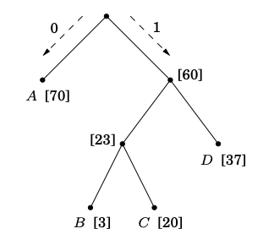
How?
Note that a prefix-free encoding can be represented using a full binary tree where the symbols are the leaves and each encoding is generated by a path from root to leaf.

Slide 34
The algorithm:
function Huffman(f): Input: An array f[1...n] of frequencies, n = number of symbols Output: An encoding tree with n leaves
let H be a priority queue of integers, ordered by f for i = 1 to n: enqueue(H, i) for k = n+1 to 2n-1: i = deletemin(H), j = deletemin(H) create a node numbered k with children i, j f[k] = f[i] + f[j] enqueue(H, k)

Slide 35
Example

Slide 36
Now you:
(Dasgupta 5.13) A long string consists of the four characters A, C, G, T; they appear with frequency 31%, 20%, 9%, and 40% respectively. What is the Huffman encoding of these four characters?
(Dasgupta 5.14) Suppose the symbols a, b, c, d, e occur with frequencies ½, ¼, ⅛, 1/16, 1/16, respectively. What is the Huffman encoding of this alphabet?
The usual: come back to the main room once complete

Slide 37
A design exercise:
(Dasgupta) Alice wants to throw a party and is deciding whom to call. She has n people to choose from, and she has made up a list of which pairs of these people know each other. She wants to pick as many people as possible, subject to two constraints: at the party, each person should have at least five other people whom they know and five other people whom they don’t know. Give an efficient, greedy algorithm that takes as input the list of n people and the list of pairs who know each other and outputs the best choice of party invitees.

